Slide 1

Police and Thief
ESP3201 Project
Machine Learning in Robotics
A0205393H Irwin Chin De Tao
A0199806L Jevan Goh

Slide 2
Content
Inspiration
Motivation
Modification
Punishment and Reward
Hypothesis
Libraries
Considerations

Slide 3
Inspiration
OpenAI: Emergent Tool Use from Multi-Agent Interaction (2019)
Teaching 2 teams of agents to play Hide N Seek
Self-Supervised Multi-Agent Reinforcement Learning
Emergent skills despite simple Visibility-based reward function

Slide 4
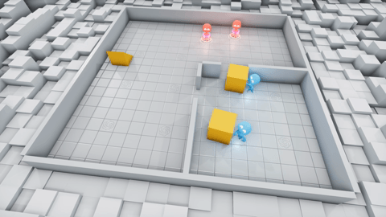
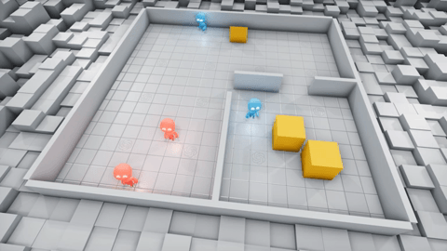
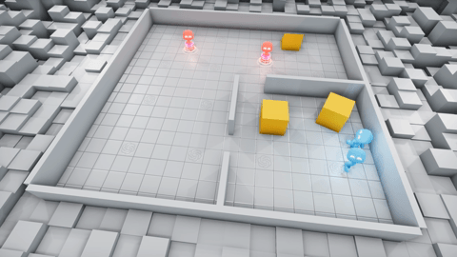
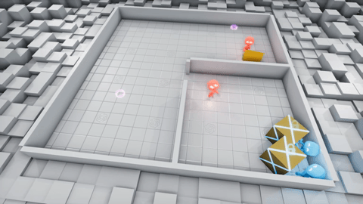
Inspiration
(OpenAI)

Slide 5
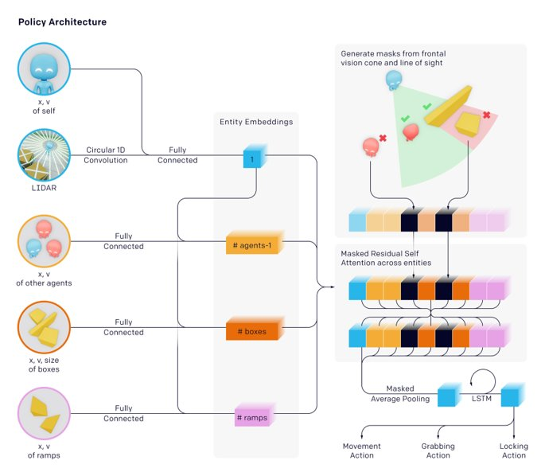
Inspiration
(OpenAI)

Slide 6
Motivation
Inspired from action movies: main character escaping
Simulation of wild goose chase environment
Optimisation of police manpower deployment
Prepare policemen for different escape routes

Slide 7
Modifications
Adapting Hide N Seek to a game of Tag
Inclusion of ‘exit point’ for the thieves to escape
Agent set-up: 4 policeman and 2 thieves
Custom obstacle course

Slide 8


Punishment and Rewards
Possible parameter(s) for reward function:
Any thief in sight: +1
All thieves out of sight: +1
No thieves reach exit point: +20
Any thief reach exit point: +20
Any thief ‘caught’: +10
No thieves ‘caught’: +10
All thieves out of sight: -1
Any thief in sight: -1
Any thief reach exit point: -20
No thieves reach exit point: -20
No thieves ‘caught’: -10
Any thief ‘caught’: -10

Slide 9
Hypothesis
Early game:
- Agents will run around aimlessly
- Police will not know how to catch thieves
- Thieves will not know how to escape
Mid Game:
- Thieves will learn to escape chase, move towards exit
- Splitting and coordination
- Both teams will learn to use objects in their favour
Late game:
- Complex strategies will be developed, possibly game-breaking

Slide 10
Libraries
Using OpenAI open source code as base:
Mujoco-worldgen
- https://github.com/openai/mujoco-worldgen
Multi-agent-emergence-environments
- https://github.com/openai/multi-agent-emergence-environments

Slide 11
Considerations
Number of agents on each team:
- Might have different strategies for each combination
Computational bottleneck:
- Significant compute required for training (> 30 hours)
Possibility of wrong convergence:
- Policy might equalise at a wrong global maximum (gradient ascend)

